Slide 1
Kafka – 102
Made by a group that learned it recently ;)

Slide 2
Agenda
Resume workshop 1
Start or resume the Code task from workshop 1
Schema Registry
Kafka Streams
Kafka Connect
Workshop 2

Slide 3
Resume workshop 1
If you have any questions, please reach out to us.

Slide 4
Short break

Slide 5
Schema Registry
https://github.com/fortedigital/cg-kafka

Slide 6
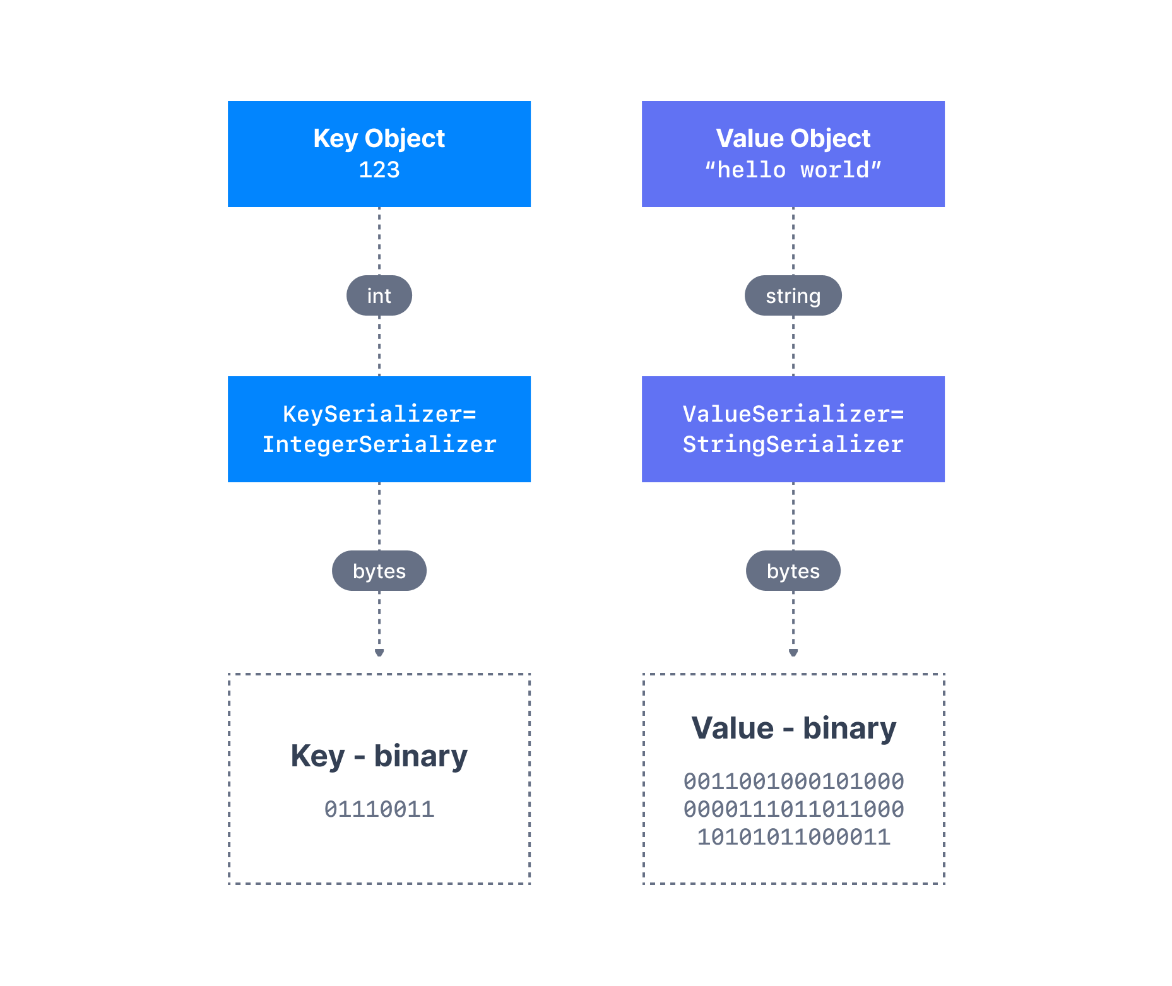
Producer – Message Serializers
Kafka only acceps and sends bytes as input and output
Seralization is used for key and value
Common Serializers
String(incl. JSON)
Int,Float
Avro
Protobuf

Slide 7
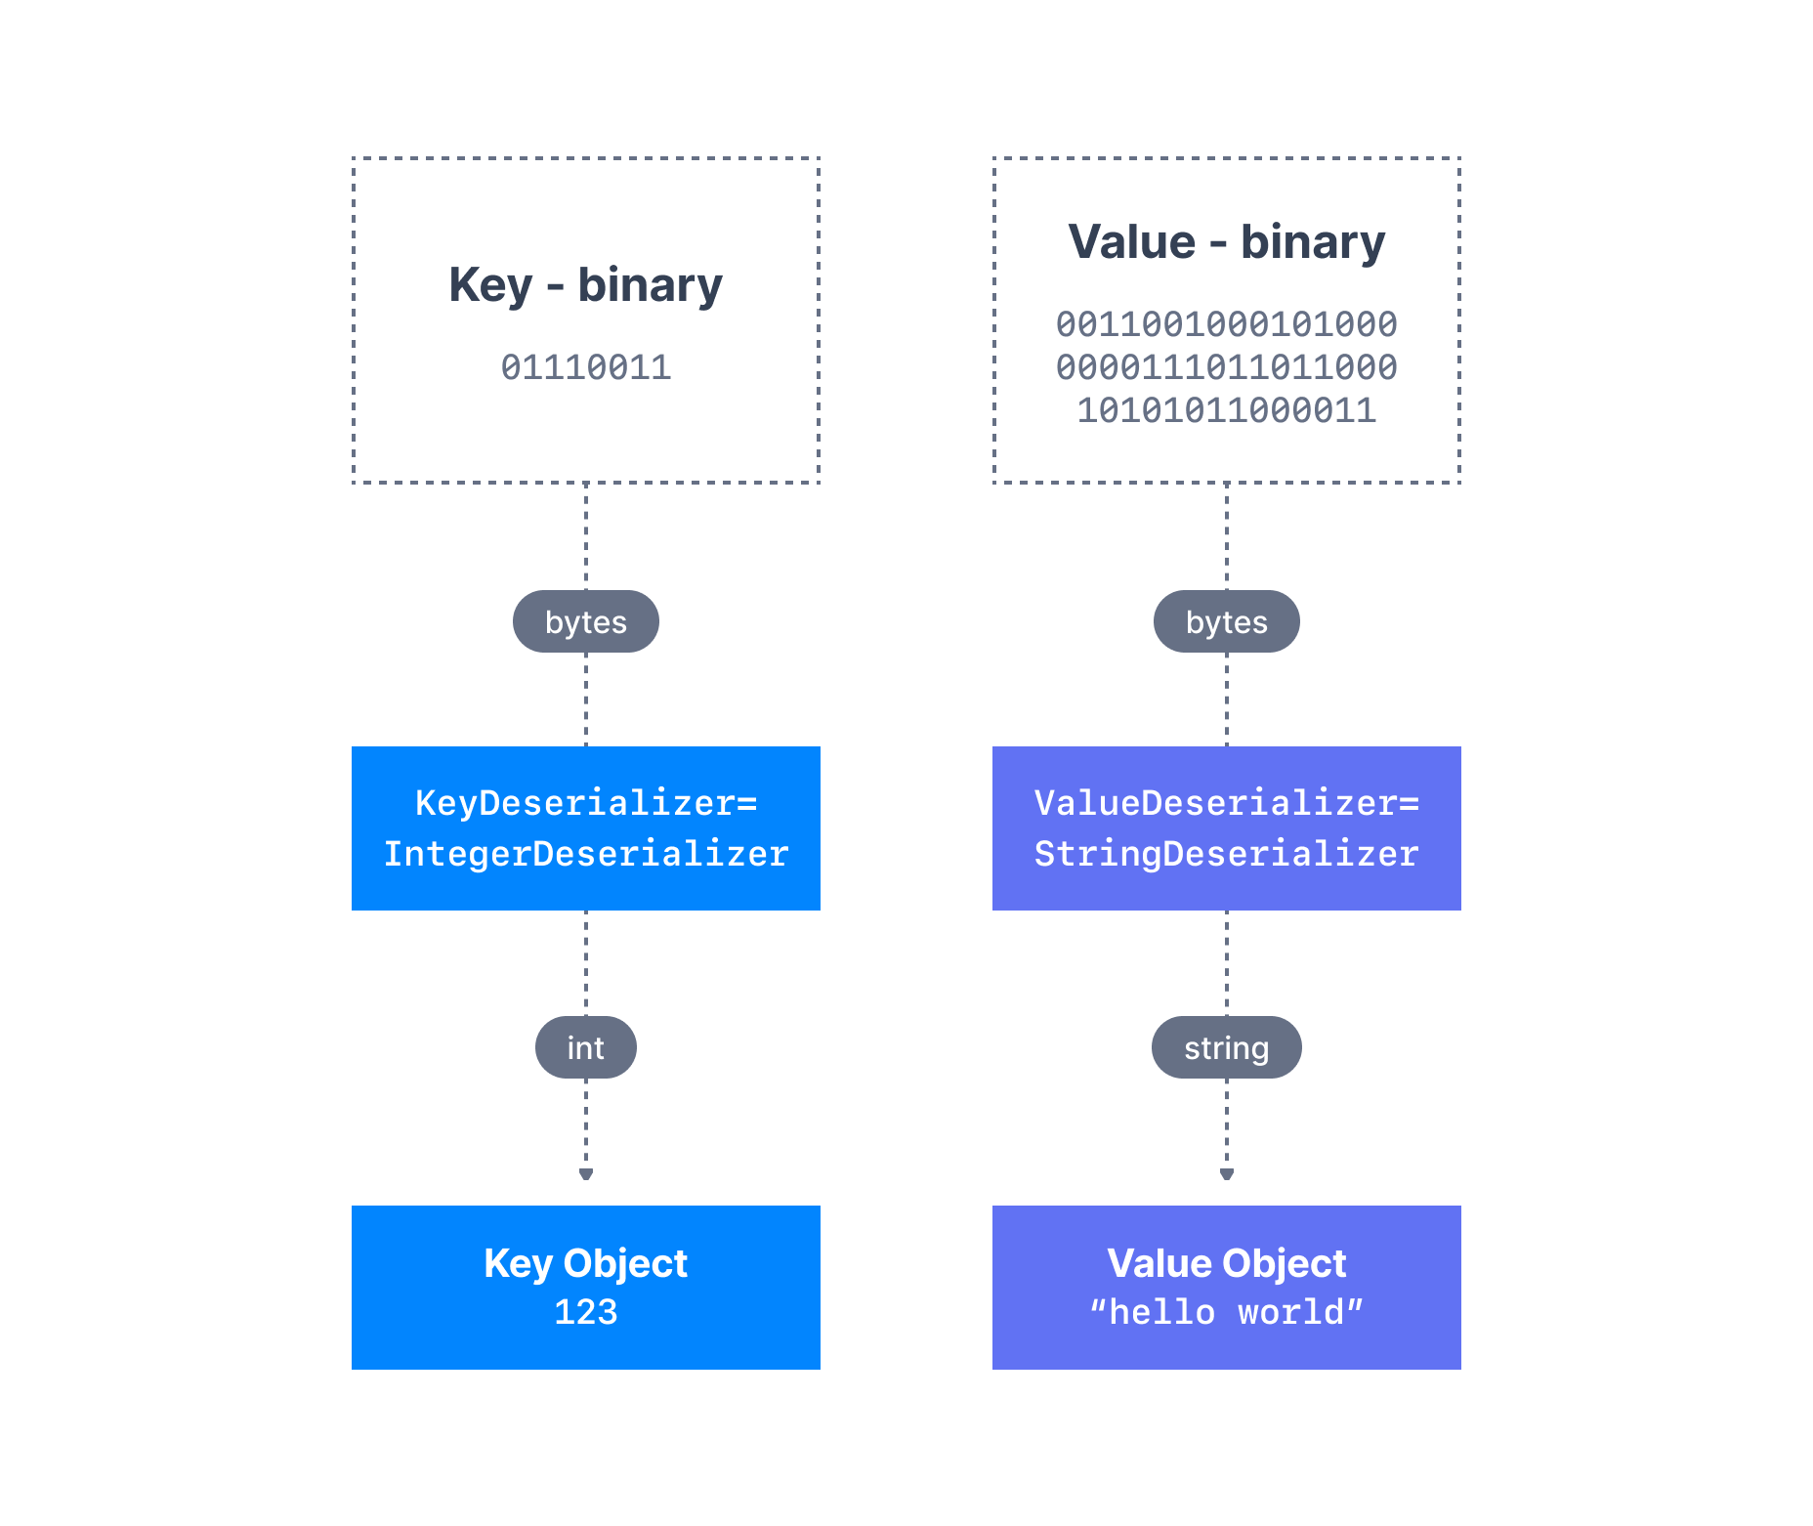
Consumer Deserializer
Deserializer is used for value and key
Common Deserializer
String (incl. JSON)
Int, Float
Avro
Protobuf
The serialization / deserialization type must not change during a topic lifecycle (Create new instead)

Slide 8
Kafka Streams

Slide 9
Kafka Connect

Slide 10
Use cases
Messaging service
Acitivty Tracking
Gathering metrics from many different localtions
Application logs
Stream processing (Kafka streams API)
De-coupling of system dependencies
Integrations with Spark, Flink, Storm, Hadoop and other Big data tech
Mirco-services pub/sub
Event-sourcing store

Slide 11
Examples
Netflix uses kafka for recommendations in real-time while watching
Uber uses kafka to gather user, taxi and trip data in real-time to compute and forecast demand, and compute surge pricing in real-time
LinkedIn uses kafka to prevent spam, collect user interactions to make better connection recommendations in real time.
Ruter uses it for something..
NB: Kafka is used as transportation mechanism of huge data flows that allow these features

Slide 12
Sources – since that is important now a days
https://www.udemy.com/course/apache-kafka/
https://www.conduktor.io/kafka/
Most of the kafka images are from here

Slide 13
Short break

Slide 14
To the tasks!
GitHub
CLI
Code
Forum
extra

Slide 15
Til neste gang
Kafka Schema Regsitry
Kafka Streams
Manipulering av Data
Kafka Connect
Code by others for sending data to and from kafka easier
Kafka ksql
SQL like querying of Kafka topics

